Slide 1
Project Presentation Phase –2
Title: Software Cost Estimation Using Backpropagation Algorithm
Presented By
Mr. Sudeep Rangan D R USN: 1BY19IS162
Mr. Samuel Sampath Kumar USN: 1BY19IS144
Ms. Anamika Sharma USN: 1BY18IS129
Mr.Apurv Jha USN: 1BY18IS028
Under the guidance of
Prof.Ravi Kumar

Slide 2
Introduction
Software cost estimation is one of the most challenging tasks in software engineering. Over the past years the estimators have used parametric cost estimation models to establish software cost, however the challenges to accurate cost estimation keep evolving with the advancing technology.This project uses Back-Propagation neural networks for software cost estimation. A model based on Neural Network has been proposed that takes the KLOC of the project as input, uses COCOMO model parameters and gives cost as output. Artificial Neural Network represents a complex set of relationships between the effort and the cost drivers and is a potential tool for estimation.

Slide 3
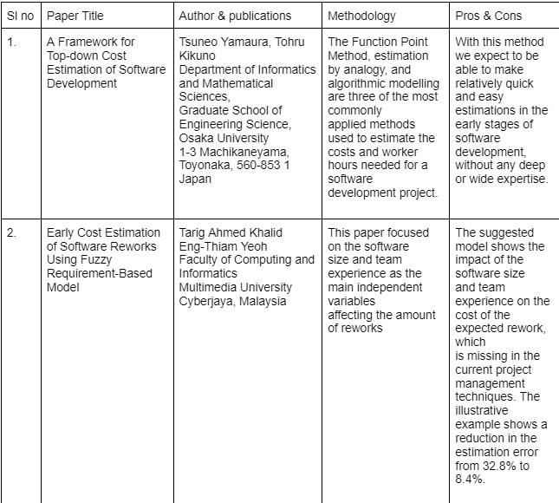
Literature Survey
24-11-2022

Slide 4
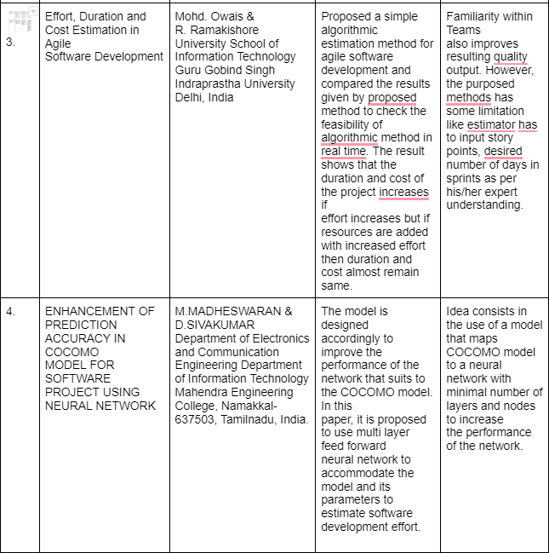
24-11-2022

Slide 5


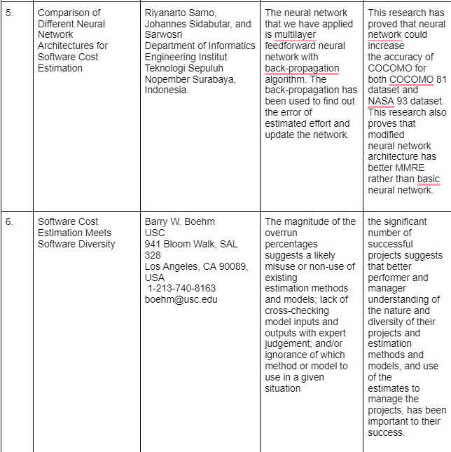
24-11-2022

Slide 6
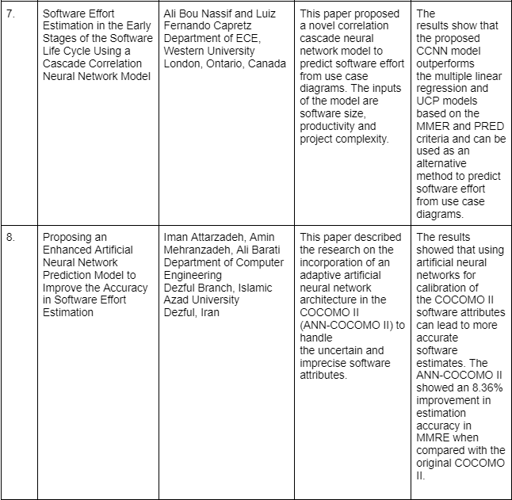
24-11-2022

Slide 7
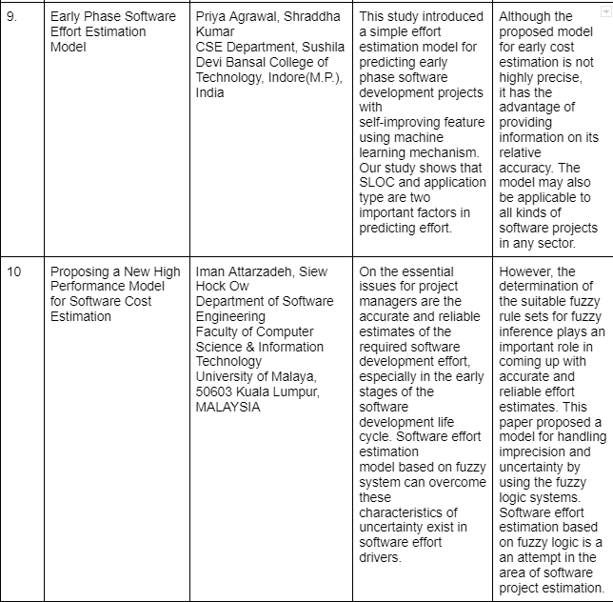
24-11-2022

Slide 8
Parameters of Software Cost
● Manpower i.e. number of engineering and management personnel allocated to the project as a function of time.
● Duration i.e. the amount of time required to complete the project.
● Effort i.e. the engineering and management effort required to complete a project.

Slide 9
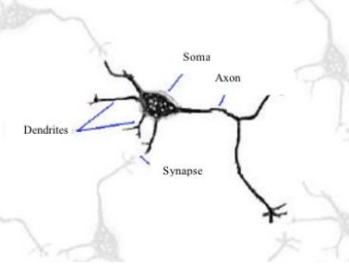
Learning By Human Brain
The basic building block of the brain and the neural network is the neuron. The Basic human neuron adapted from (Beale and Jackson, 1990).
Mathematically, the dendrite's function can be approximated as a summation. Axons, on the other hand, are found only on output cells

Slide 10


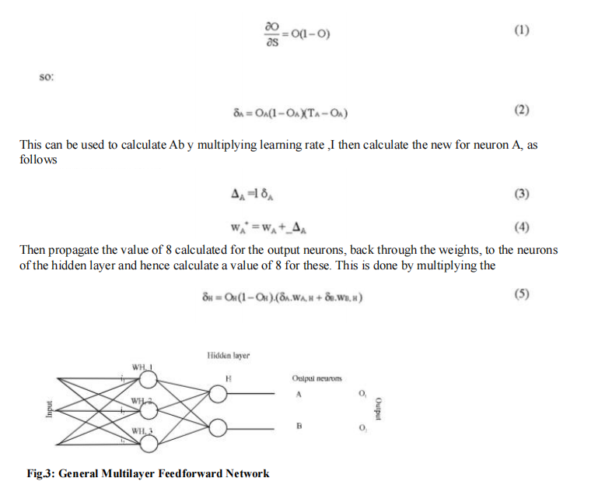
Equations

Slide 11
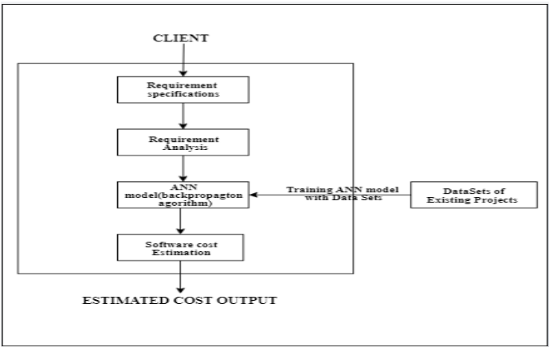

Slide 12

System Requirement Specifications
System Requirement Specifications:
Hardware Requirements:
● 4 GB RAM
● 5 GB free disk space
● x86 64-bit CPU (Intel / AMD architecture)
Software Requirement:
Modern Operating System:
● IDE – Microsoft Visual Studio Code
● Web Browser – Firefox , Google Chrome
● Operating system – Windows 7 / Ubuntu 16.04
● JDK 19
24-11-2022
12

Slide 13


13

